Slide 1
Generalized Group Lasso for Predictive Biomarker Identification
Wenxuan Deng
Working with Kevin Galinsky and Jacob Zhang

Slide 2
Outline
Background:
What is predictive biomarker?
Variable Selection with Lasso
Model:
Linear model
Group Lasso penalty term design
Simulations
Proportions of nonzero interactions
Signal to Noise ratio
Large-scale high dimensional data
Conclusions

Slide 3
Background

Slide 4
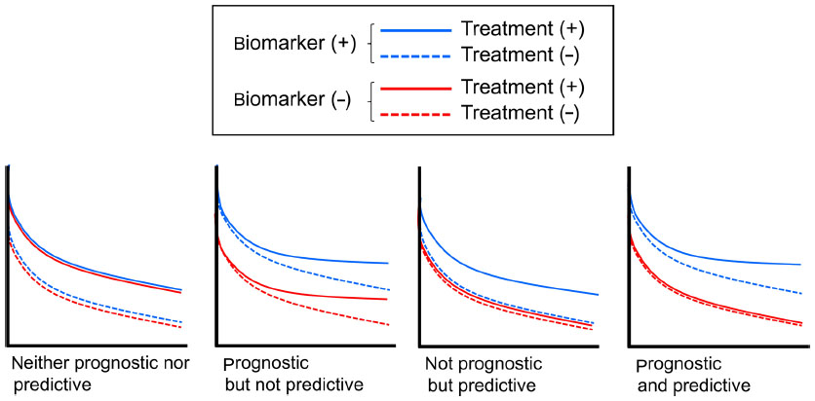
Prognostic Biomarkers and Predictive Biomarkers
Mukohara, Toru. Breast Cancer: Targets and Therapy 7 (2015)

Slide 5
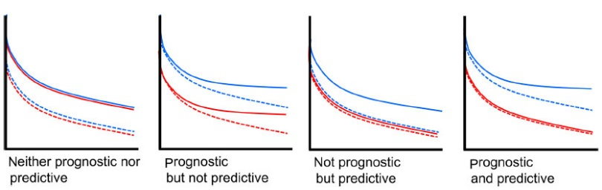

Slide 6
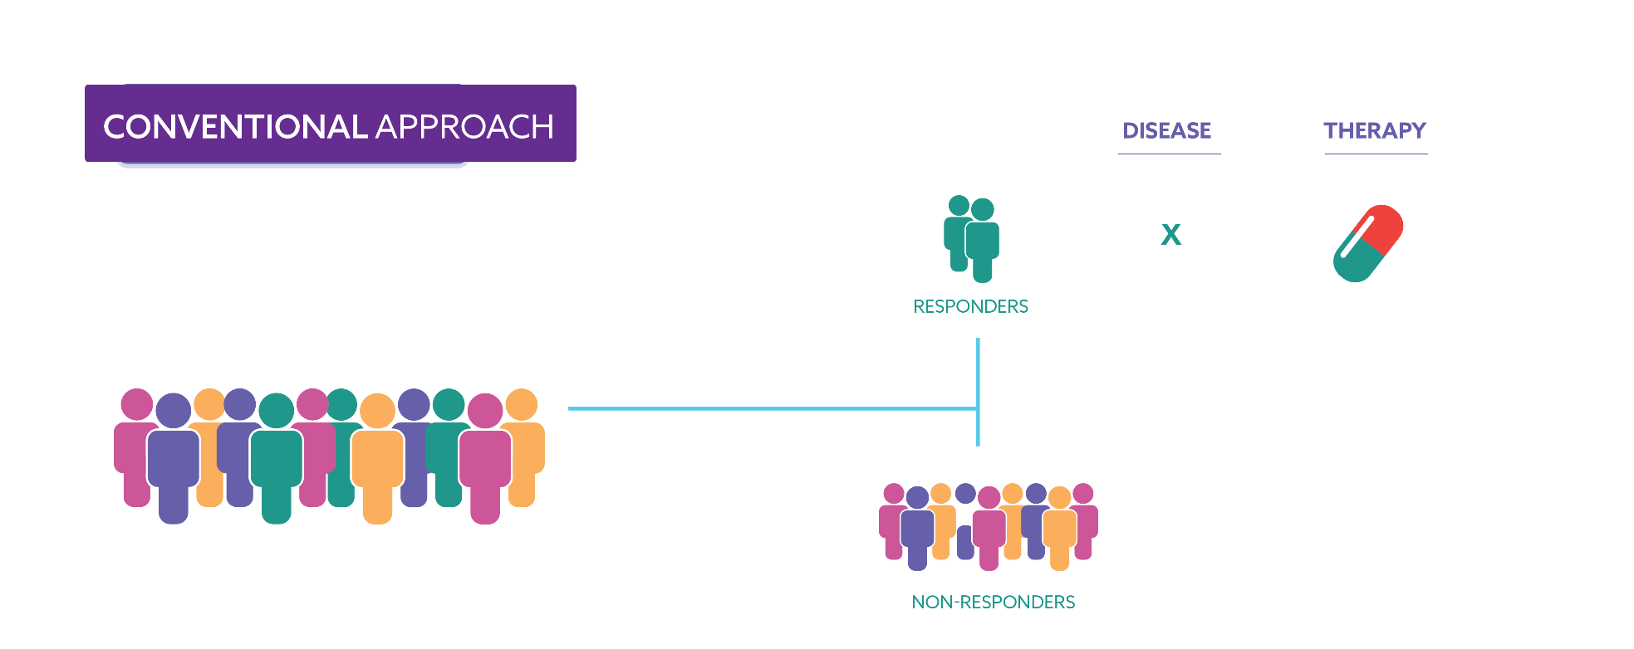
Patient Subgroup Identification
X
X

Slide 7
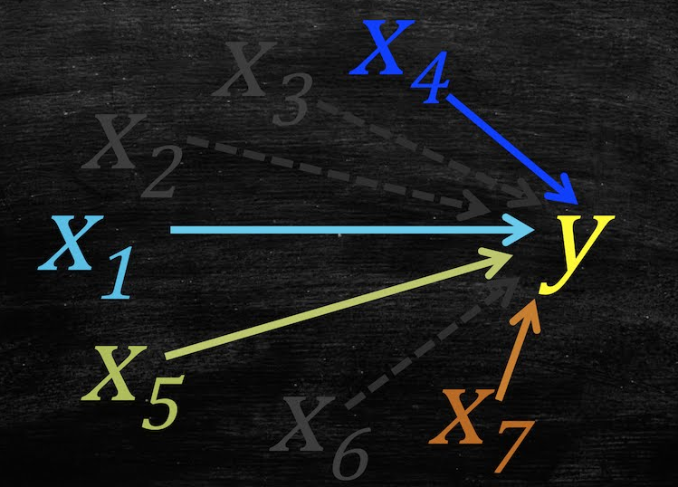

Variable Selection
Lasso

Slide 8
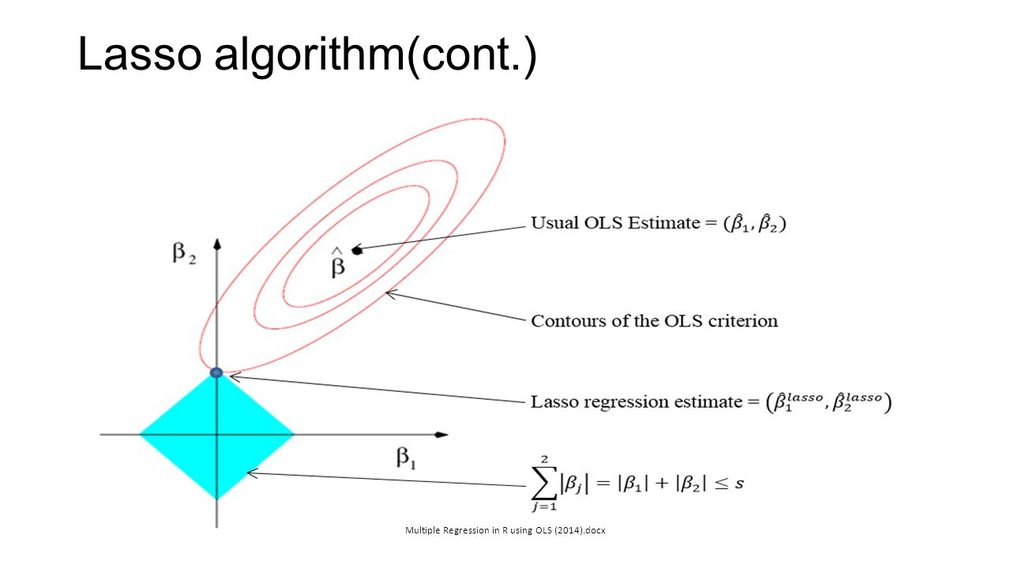

Lasso
Penalization
$\min_{β}\frac{1}{2}∥Y−Xβ∥^{2}$ $+λ{\left|β\right|}_{1}$
$$\min_{β}\frac{1}{2}∥Y−Xβ∥^{2}$$
$$s.t. {\left|β\right|}_{1}<t$$

Slide 9
Model

Slide 10
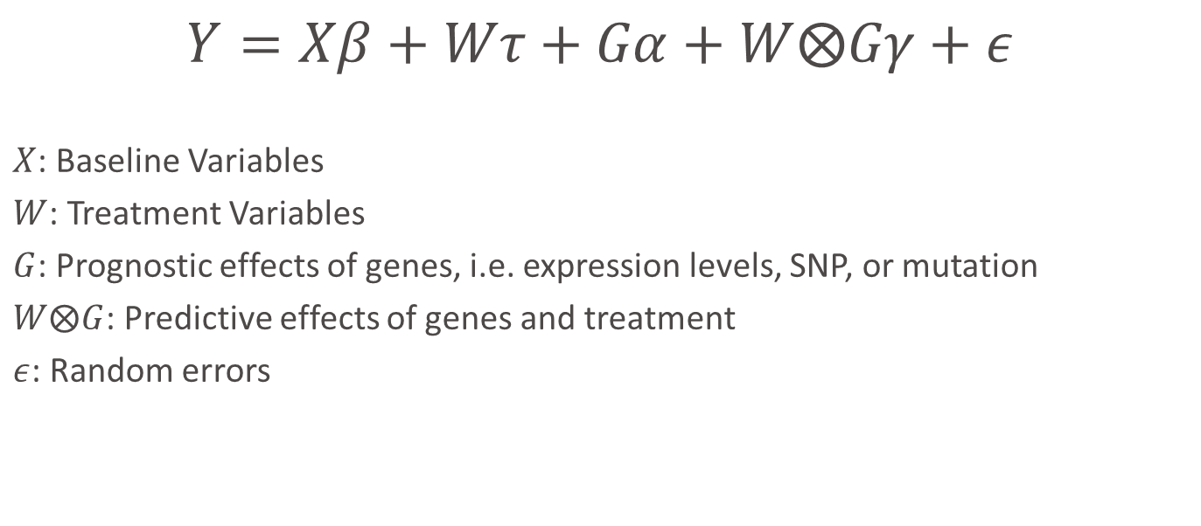
Model
$$Y=Xβ+Wτ+Gα+W⨂Gγ+ε$$
$X$: Baseline Variables
$W$: Treatment Variables
$G$: Prognostic effects of genes, i.e. expression levels, SNP, or mutation
$W⨂G$: Predictive effects of genes and treatment
$ε$: Random errors

Slide 11
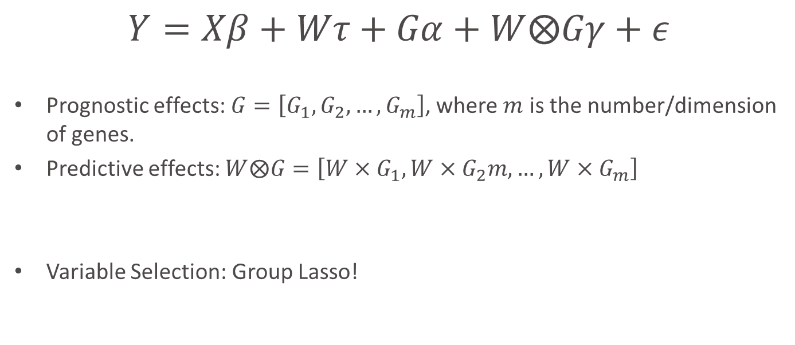
Model
$$Y=Xβ+Wτ+Gα+W⨂Gγ+ε$$
Prognostic effects: $G=\left[G_{1},G_{2},…, G_{m}\right]$, where $m$ is the number/dimension of genes.
Predictive effects: $W⨂G=\left[W×G_{1},W×G_{2}m,…,W×G_{m}\right]$
Variable Selection: Group Lasso!

Slide 12
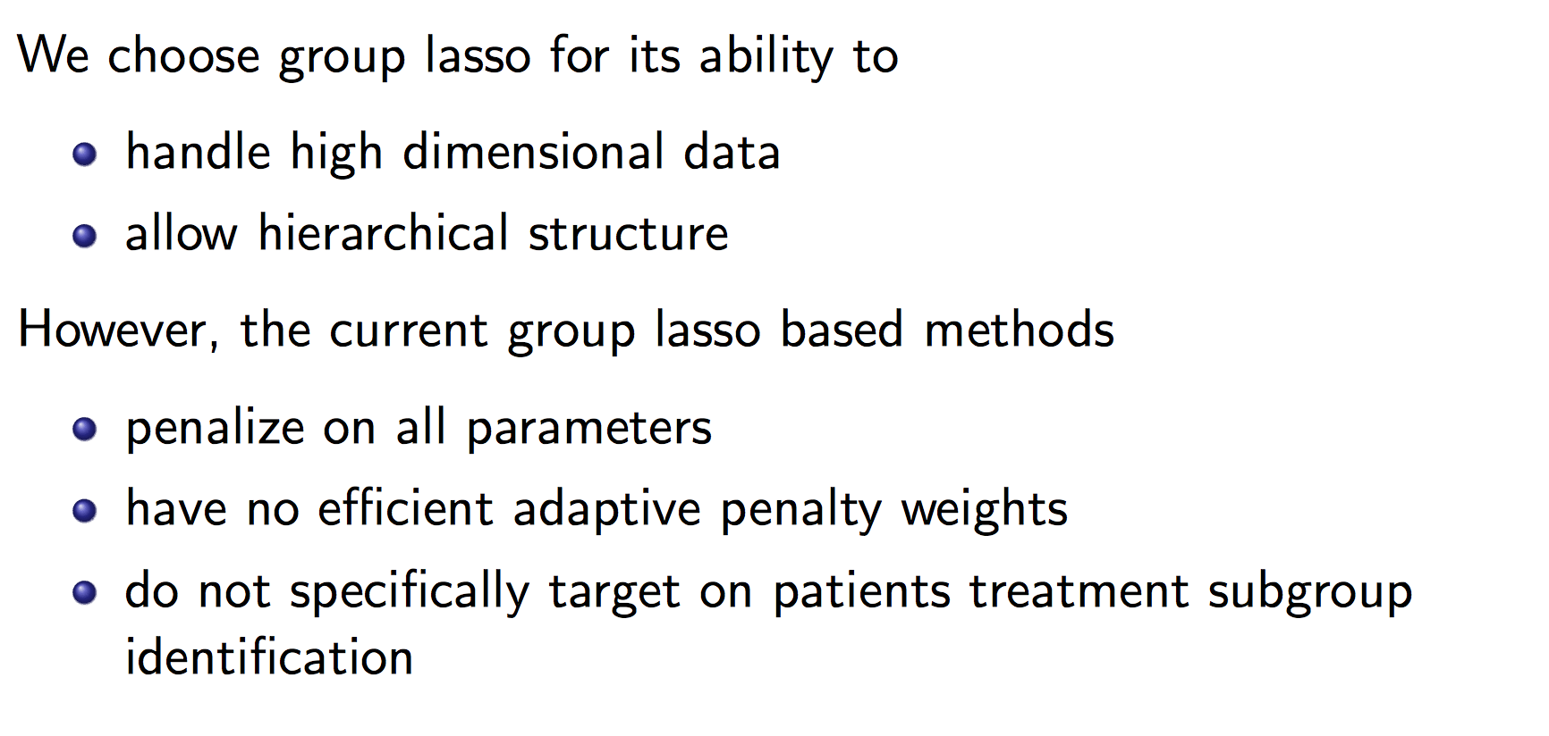
Group Lasso

Slide 13
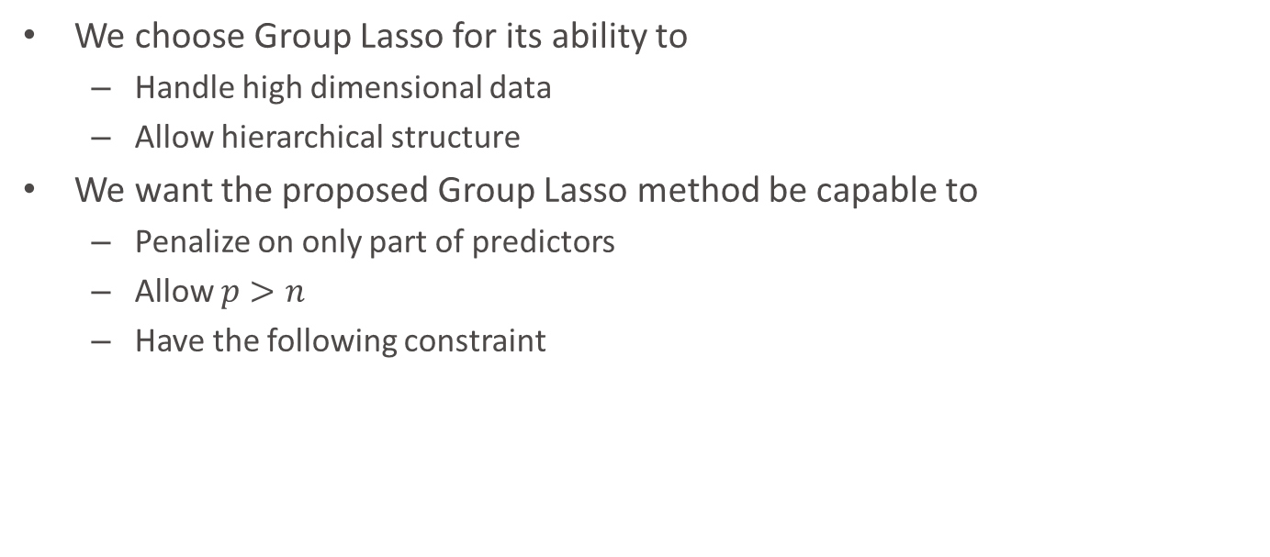
Group Lasso
We choose Group Lasso for its ability to
Handle high dimensional data
Allow hierarchical structure
We want the proposed Group Lasso method be capable to
Penalize on only part of predictors
Allow $p>n$
Have the following constraint

Slide 14
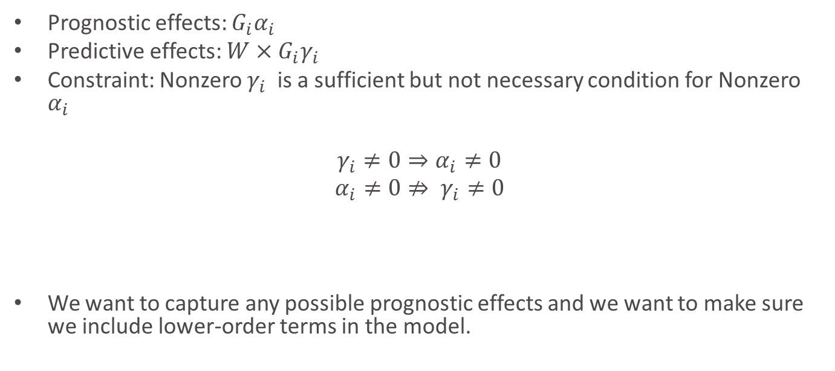
Constraint
Prognostic effects: $G_{i}α_{i}$
Predictive effects: $W×G_{i}γ_{i}$
Constraint: Nonzero $γ_{i}$is a sufficient but not necessary condition for Nonzero $α_{i}$
$γ_{i}≠0⇒α_{i}≠0$
$$α_{i}≠0⇏ γ_{i}≠0$$
We want to capture any possible prognostic effects and we want to make sure we include lower-order terms in the model.

Slide 15
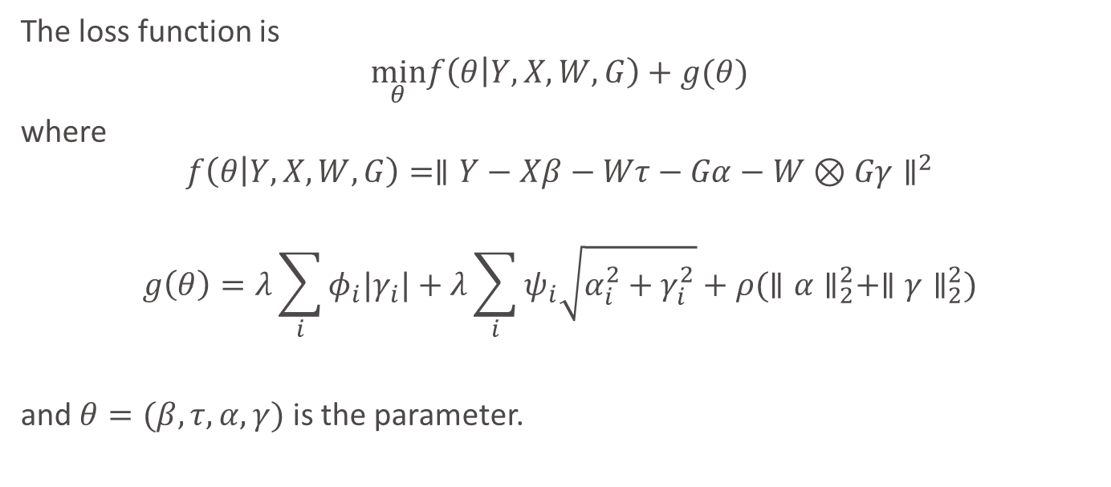
Loss Function
The loss function is
$$\min_{θ}f\left(θ | Y,X,W,G\right)+g(θ)$$
where
$$f\left(θ | Y,X,W,G\right)=∥Y−Xβ−Wτ−Gα−W⊗Gγ∥^{2}$$
$$g\left(θ\right)=λ\sum_{i}{φ_{i}|γ_{i}|}+λ\sum_{i}{ψ_{i}\sqrt{α_{i}^{2}+γ_{i}^{2}}+ρ(∥α∥_{2}^{2}+∥γ∥_{2}^{2})}$$
and $θ=(β,τ,α,γ)$ is the parameter.
Group Lasso Structure
Elastic Net
Regularization
Parameter

Slide 16
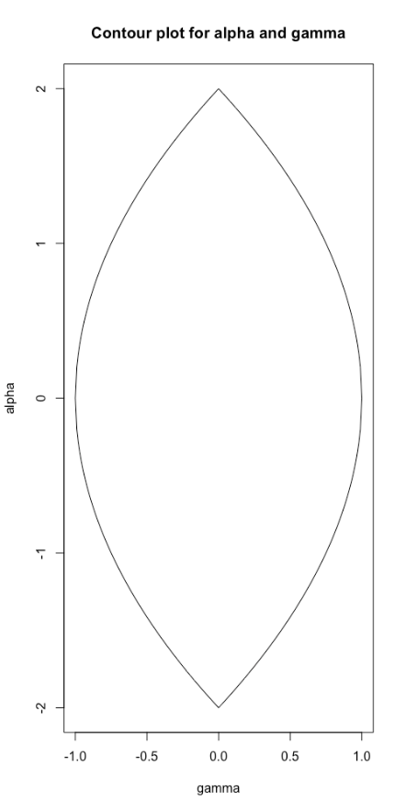




Geographical Interpretation of Group Lasso Structure
$$γ=0, α≠0$$
Convex function $f(α,γ)$
$$g\left(α,γ\right)=\left|γ\right|+\sqrt{α^{2}+γ^{2}}$$
$$γ≠0, α≠0$$

Slide 17
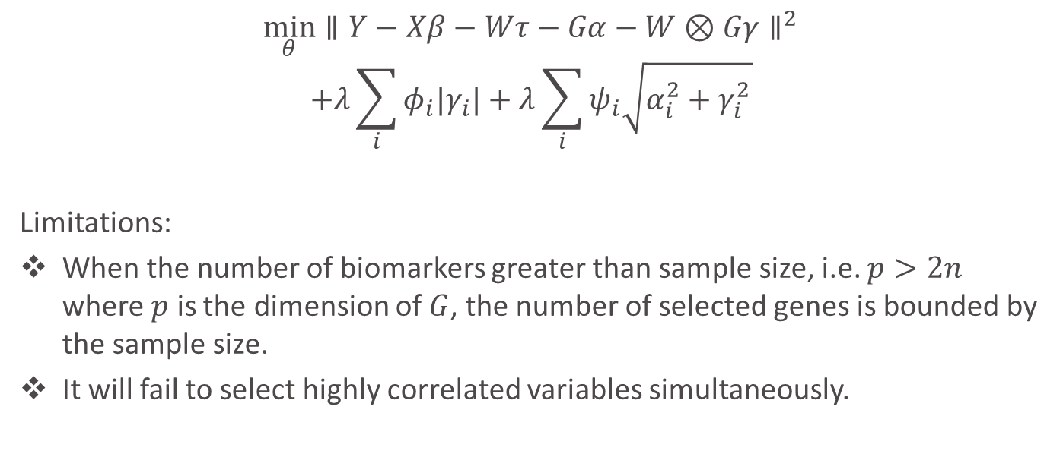
If Without Elastic Net Structure…
$$\min_{θ}∥Y−Xβ−Wτ−Gα−W⊗Gγ∥^{2}$$
$$+λ\sum_{i}{φ_{i}|γ_{i}|}+λ\sum_{i}{ψ_{i}\sqrt{α_{i}^{2}+γ_{i}^{2}}}$$
Limitations:
When the number of biomarkers greater than sample size, i.e. $p>2n$ where $p$ is the dimension of $G$, the number of selected genes is bounded by the sample size.
It will fail to select highly correlated variables simultaneously.

Slide 18
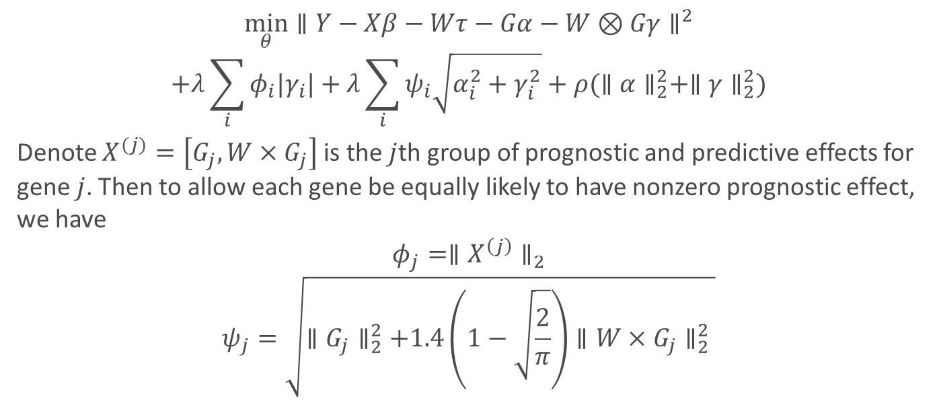
Adaptive Weights
$$\min_{θ}∥Y−Xβ−Wτ−Gα−W⊗Gγ∥^{2}$$
$$+λ\sum_{i}{φ_{i}|γ_{i}|}+λ\sum_{i}{ψ_{i}\sqrt{α_{i}^{2}+γ_{i}^{2}}}+ρ(∥α∥_{2}^{2}+∥γ∥_{2}^{2})$$
Denote $X^{(j)}=\left[G_{j},W×G_{j}\right]$ is the $j$th group of prognostic and predictive effects for gene $j$. Then to allow each gene be equally likely to have nonzero prognostic effect, we have
$$φ_{j}=∥X^{\left(j\right)}∥_{2}$$
$$ψ_{j}=\sqrt{∥G_{j}∥_{2}^{2}+1.4\left(1−\sqrt{\frac{2}{π}}\right)∥W×G_{j}∥_{2}^{2} }$$
Adaptive Weight

Slide 19
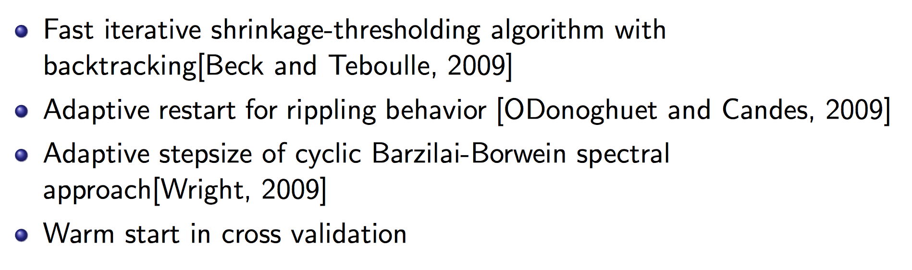
Optimization Strategies

Slide 20
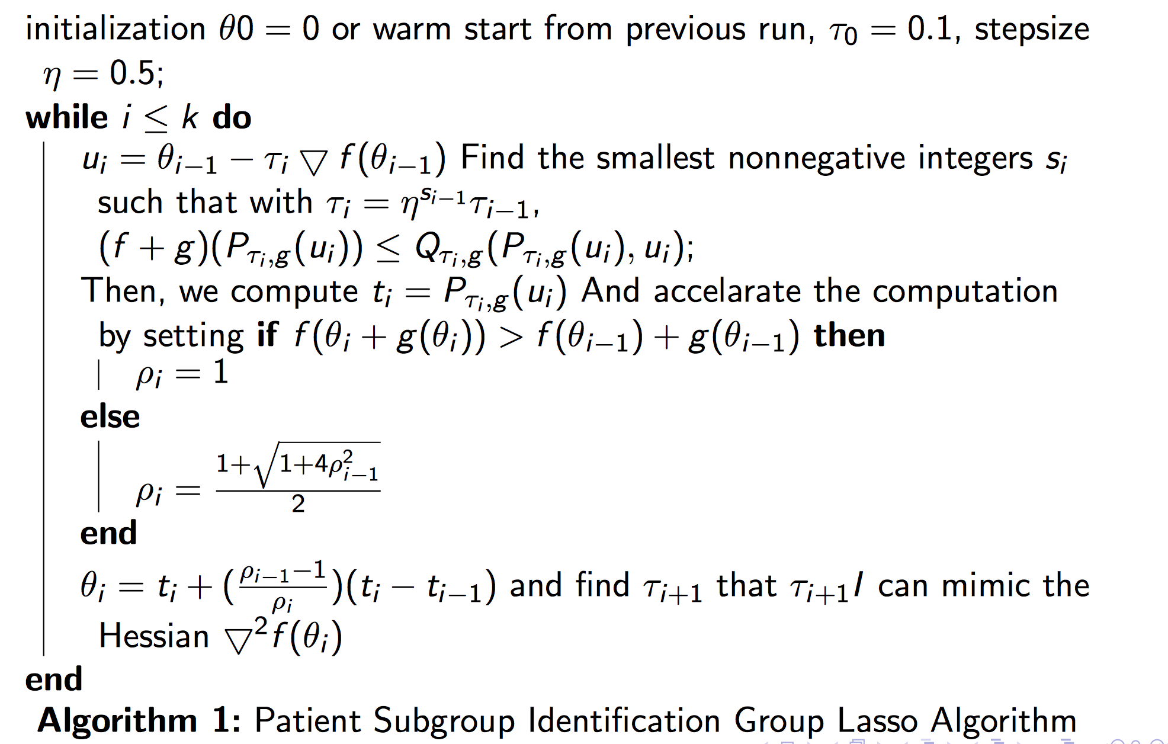
Algorithm

Slide 21
Simulations

Slide 22
Simulation Setup
N=100
Dimensions for baseline variables = 5 (Standard Normal Distribution)
Dimensions for treatment variable = 1, (binary: +1,-1)
Dimensions for Genes = 50, 100,200 (Standard Normal Distribution/Binomial Distribution)
Coefficients for baseline and treatment variables: standard normal distribution
Coefficients for genes=+3,-3,+5,-5

Slide 23

Simulation Setup
5%, 10%, 15%, 20% of genes have predictive effects
10%, 20%, 30%, 40% of genes have prognostic effects
Iterations: 100
Prognostic Effects
40%
Predictive Effects
20%
$m$ genes

Slide 24
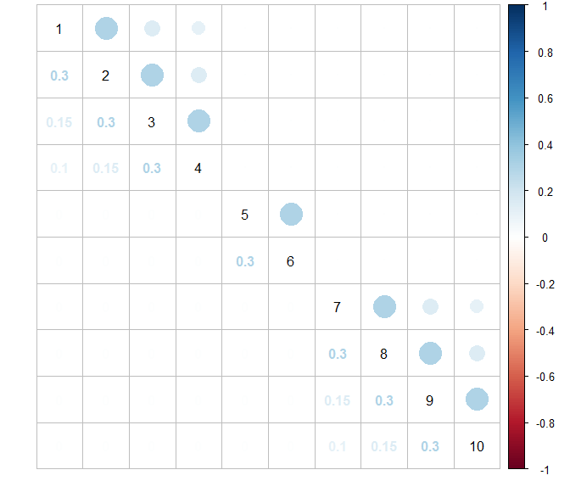
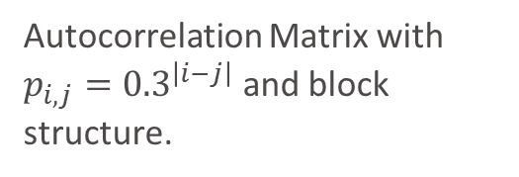
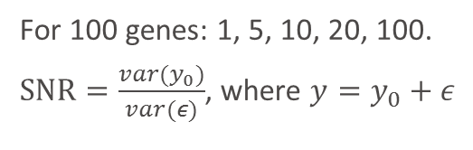
Correlation Structure
Simulation Setup
Autocorrelation Matrix with $p_{i,j}={0.3}^{\left|i−j\right|}$ and block structure.
Signal to Noise ratio (SNR)
For 100 genes: 1, 5, 10, 20, 100.
$SNR=\frac{var(y_{0})}{var(ε)}$, where $y=y_{0}+ε$

Slide 25
Fixed number of genes: 100
Fixed SNR=10
SNR
Fixed number of genes: 100
Fixed covariates data type: Standard Normal Distribution
Fixed covariates data type: Standard Normal Distribution
Dimension
Fixed proportion of nonzero predictive biomarkers: 10%
Fixed SNR=10
Fixed covariates data type: Standard Normal Distribution
SNP
Proportion
Fixed proportion of nonzero predictive biomarkers: 10%
Fixed number of genes: 100
Fixed proportion of nonzero predictive biomarkers: 10%
Fixed SNR=10

Slide 26
Other methods
General Elastic Net without penalizing baseline and treatment variables (Lasso)
Bayesian Model Averaging (BMA)
Stepwise Variable Selection by likelihood (step)
Iterative Sure Independent Screening (SIS)
Random Forest

Slide 27
Proportion of nonzero interactions
Fixed number of genes: 100
Fixed SNR=10
Fixed covariates data type: Standard Normal Distribution

Slide 28
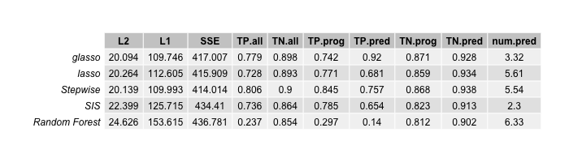
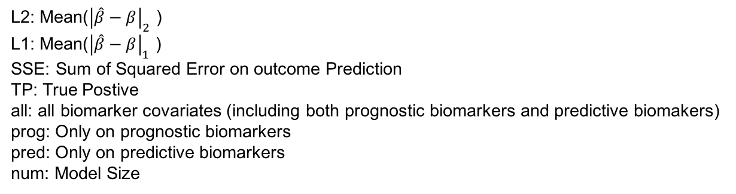
Nonzero Interaction Effects Proportion=5%
L2: Mean(${\left|\hat{β}−β\right|}_{2}$ )
L1: Mean(${\left|\hat{β}−β\right|}_{1}$ )
SSE: Sum of Squared Error on outcome Prediction
TP: True Postive
all: all biomarker covariates (including both prognostic biomarkers and predictive biomakers)
prog: Only on prognostic biomarkers
pred: Only on predictive biomarkers
num: Model Size

Slide 29
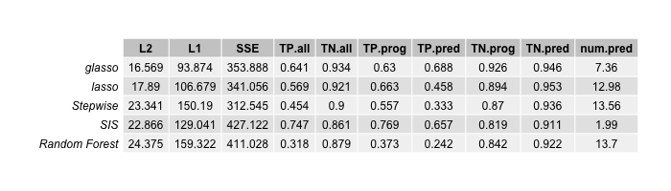
Nonzero Interaction Effects Proportion=10%
L2: Mean(${\left|\hat{β}−β\right|}_{2}$ )
L1: Mean(${\left|\hat{β}−β\right|}_{1}$ )
SSE: Sum of Squared Error on outcome Prediction
TP: True Postive
all: all biomarker covariates (including both prognostic biomarkers and predictive biomakers)
prog: Only on prognostic biomarkers
pred: Only on predictive biomarkers
num: Model Size

Slide 30
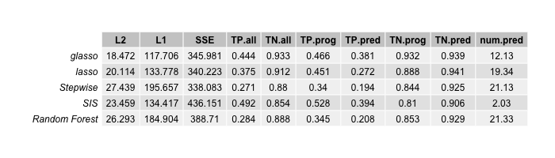
Nonzero Interaction Effects Proportion=0.15
L2: Mean(${\left|\hat{β}−β\right|}_{2}$ )
L1: Mean(${\left|\hat{β}−β\right|}_{1}$ )
SSE: Sum of Squared Error on outcome Prediction
TP: True Postive
all: all biomarker covariates (including both prognostic biomarkers and predictive biomakers)
prog: Only on prognostic biomarkers
pred: Only on predictive biomarkers
num: Model Size

Slide 31
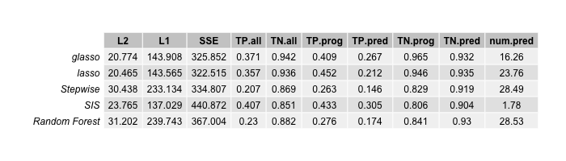
Nonzero Interaction Effects Proportion=0.2
L2: Mean(${\left|\hat{β}−β\right|}_{2}$ )
L1: Mean(${\left|\hat{β}−β\right|}_{1}$ )
SSE: Sum of Squared Error on outcome Prediction
TP: True Postive
all: all biomarker covariates (including both prognostic biomarkers and predictive biomakers)
prog: Only on prognostic biomarkers
pred: Only on predictive biomarkers
num: Model Size

Slide 32
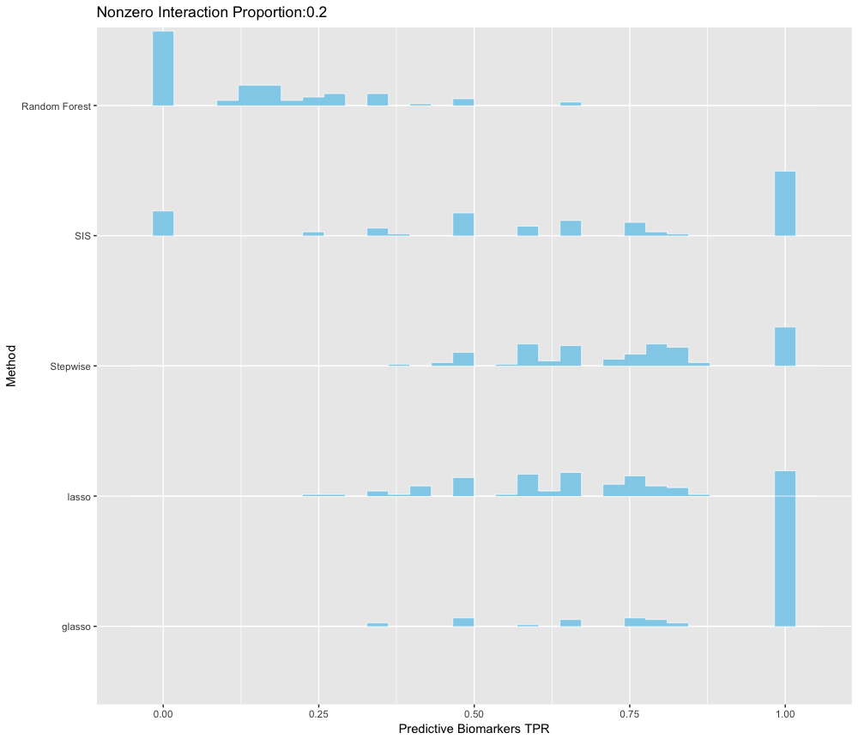
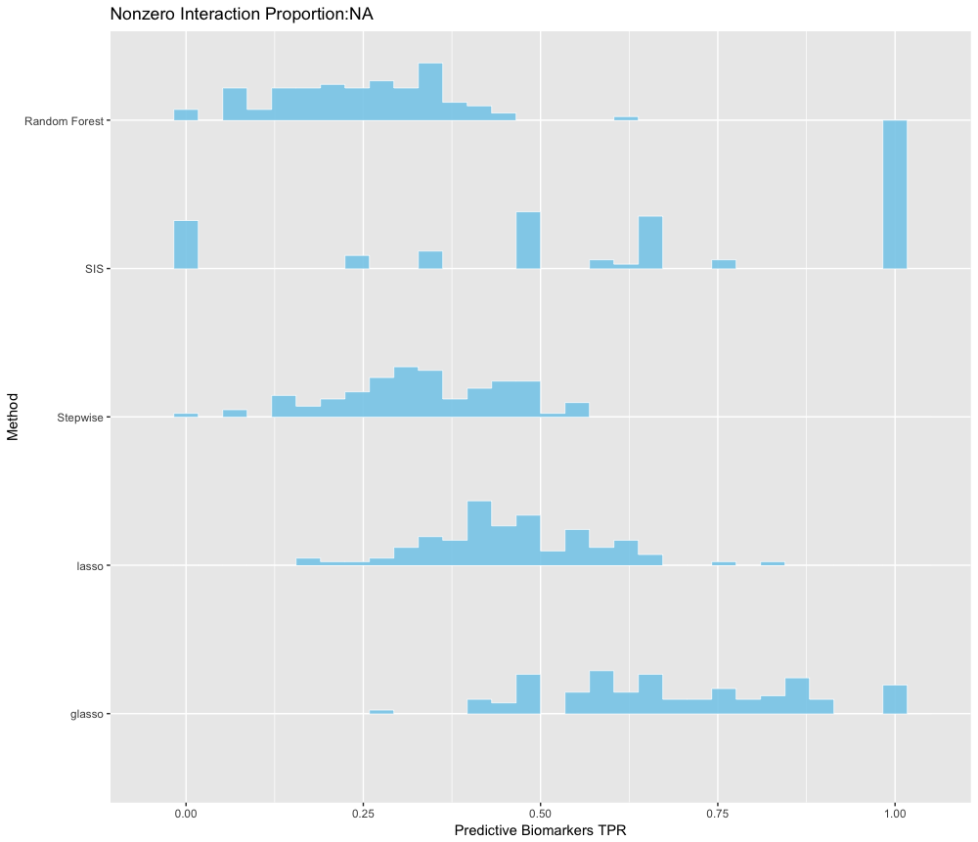
Distributions of TPR on Predictive Biomarkers Across All Simulations
Proportion=5%
Proportion=10%

Slide 33
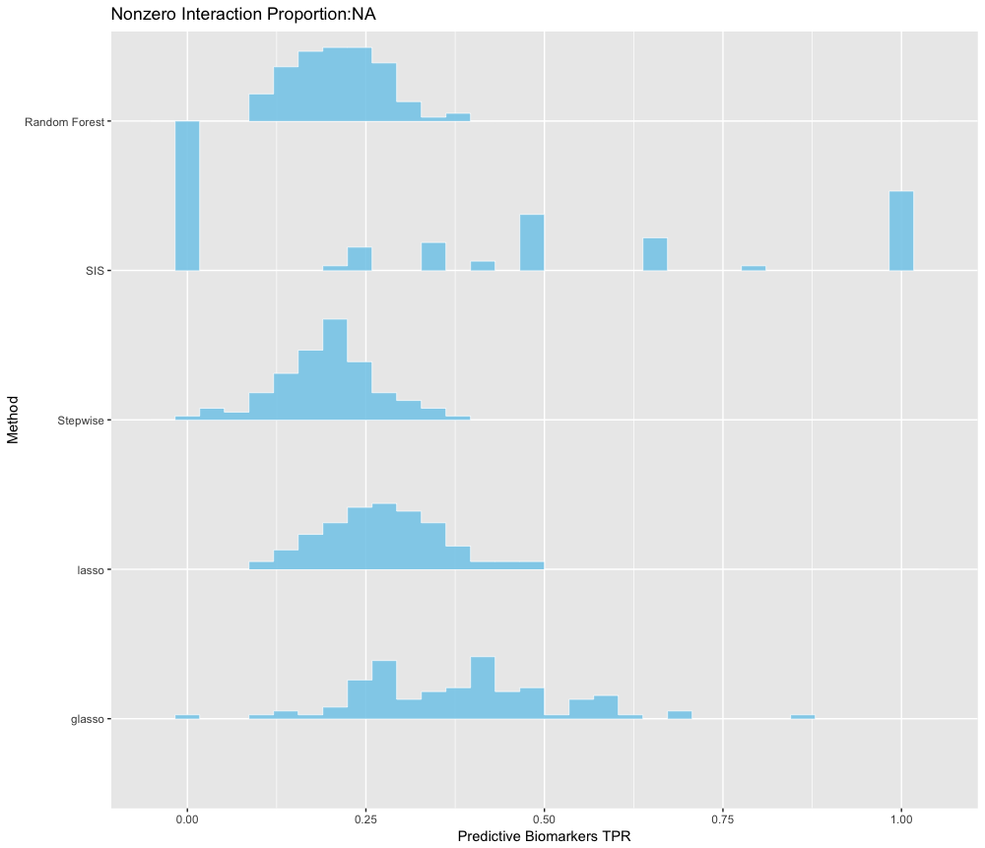
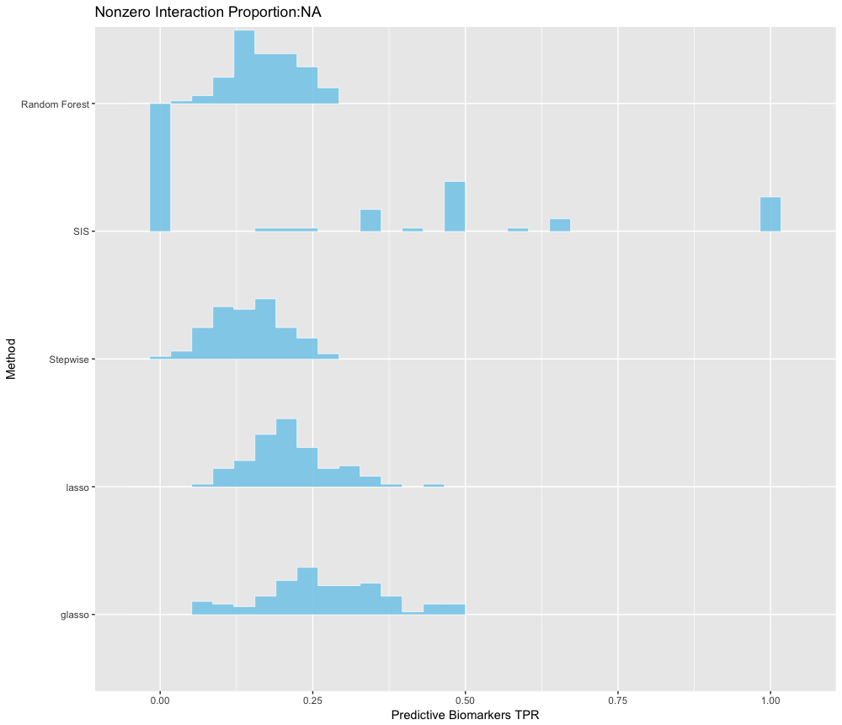
Distributions of TPR on Predictive Biomarkers Across All Simulations
Proportion=15%
Proportion=20%

Slide 34
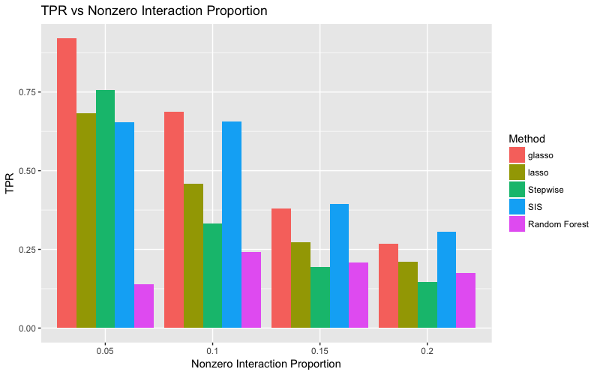

Slide 35
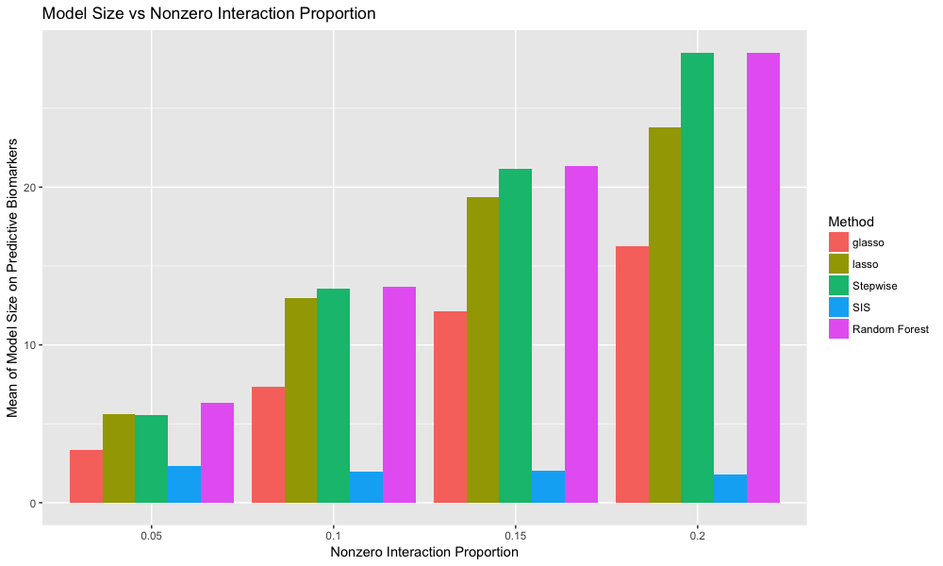

Slide 36
Signal to Noise Ratio (SNR)
Fixed number of genes: 100
Fixed proportion of nonzero predictive biomarkers: 10%
Fixed covariates data type: Standard Normal Distribution

Slide 37

SNR=1
L2: Mean(${\left|\hat{β}−β\right|}_{2}$ )
L1: Mean(${\left|\hat{β}−β\right|}_{1}$ )
SSE: Sum of Squared Error on outcome Prediction
TP: True Postive
all: all biomarker covariates (including both prognostic biomarkers and predictive biomakers)
prog: Only on prognostic biomarkers
pred: Only on predictive biomarkers
num: Model Size

Slide 38
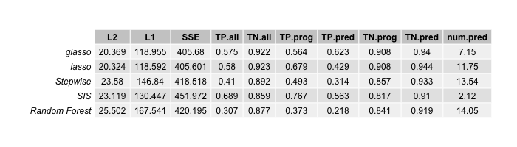
SNR=5
L2: Mean(${\left|\hat{β}−β\right|}_{2}$ )
L1: Mean(${\left|\hat{β}−β\right|}_{1}$ )
SSE: Sum of Squared Error on outcome Prediction
TP: True Postive
all: all biomarker covariates (including both prognostic biomarkers and predictive biomakers)
prog: Only on prognostic biomarkers
pred: Only on predictive biomarkers
num: Model Size

Slide 39
SNR=10
L2: Mean(${\left|\hat{β}−β\right|}_{2}$ )
L1: Mean(${\left|\hat{β}−β\right|}_{1}$ )
SSE: Sum of Squared Error on outcome Prediction
TP: True Postive
all: all biomarker covariates (including both prognostic biomarkers and predictive biomakers)
prog: Only on prognostic biomarkers
pred: Only on predictive biomarkers
num: Model Size

Slide 40

SNR=20
L2: Mean(${\left|\hat{β}−β\right|}_{2}$ )
L1: Mean(${\left|\hat{β}−β\right|}_{1}$ )
SSE: Sum of Squared Error on outcome Prediction
TP: True Postive
all: all biomarker covariates (including both prognostic biomarkers and predictive biomakers)
prog: Only on prognostic biomarkers
pred: Only on predictive biomarkers
num: Model Size

Slide 41
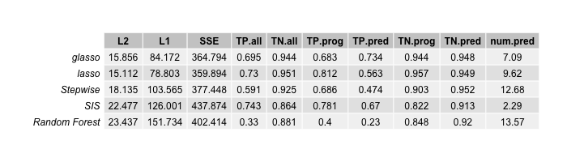
SNR=100
L2: Mean(${\left|\hat{β}−β\right|}_{2}$ )
L1: Mean(${\left|\hat{β}−β\right|}_{1}$ )
SSE: Sum of Squared Error on outcome Prediction
TP: True Postive
all: all biomarker covariates (including both prognostic biomarkers and predictive biomakers)
prog: Only on prognostic biomarkers
pred: Only on predictive biomarkers
num: Model Size

Slide 42
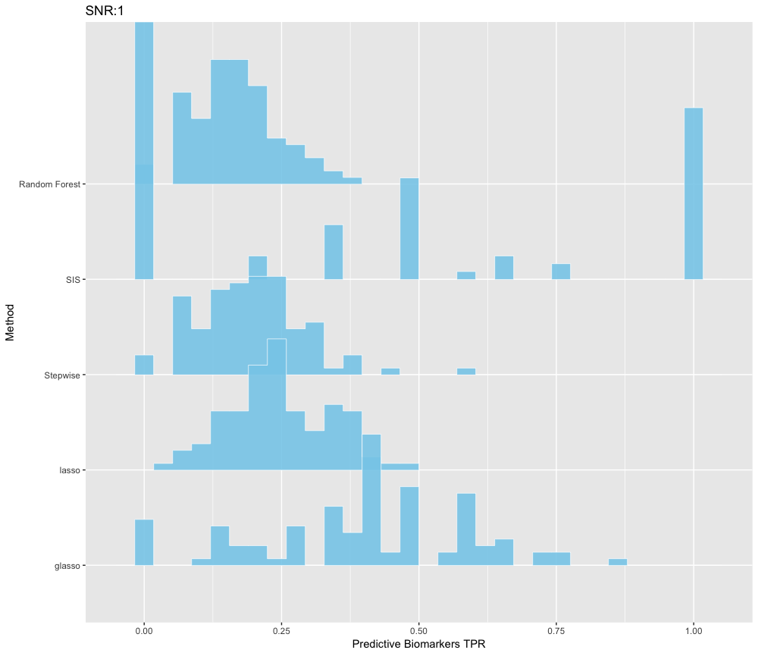
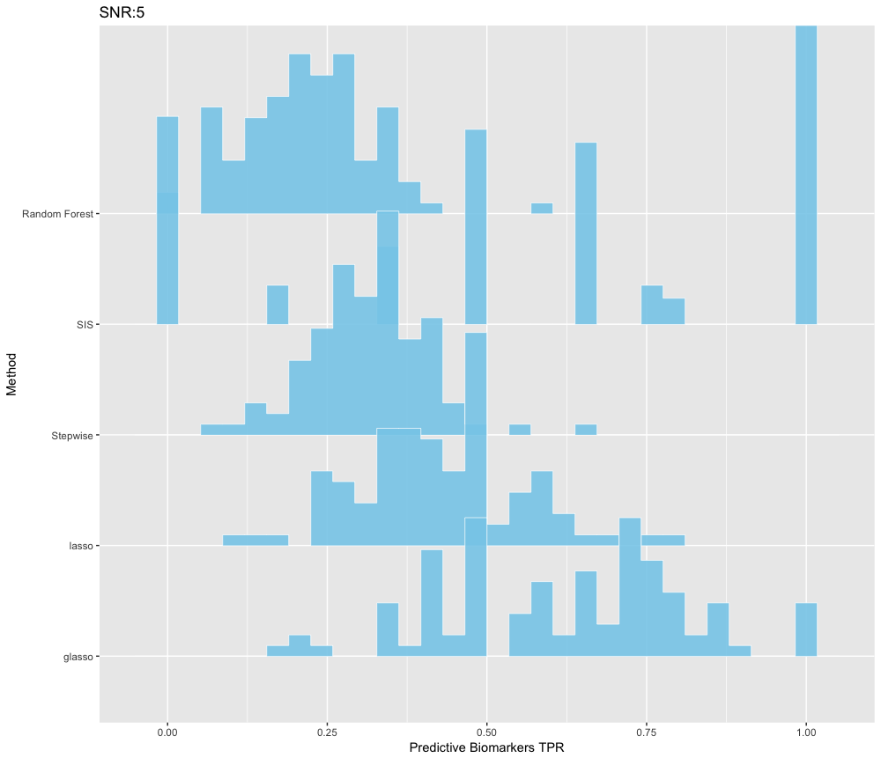
Distributions of TPR on Predictive Biomarkers Across All Simulations
SNR=1
SNR=5

Slide 43
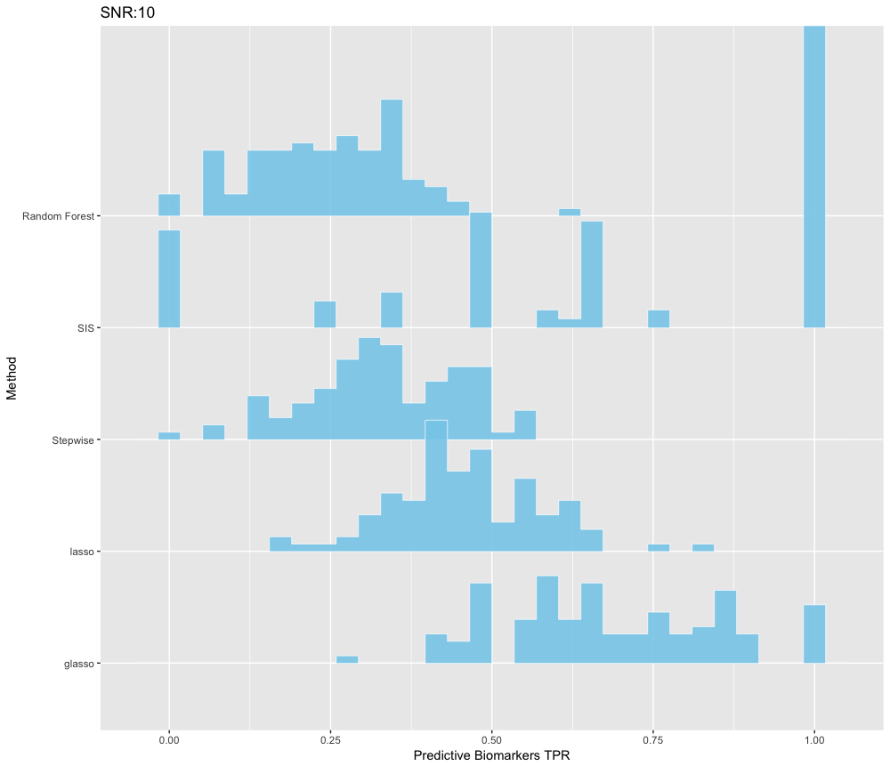
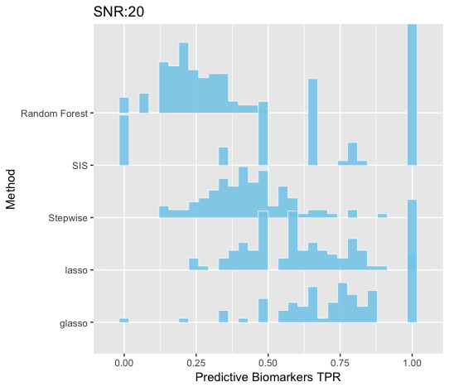
Distributions of TPR on Predictive Biomarkers Across All Simulations
SNR=10
SNR=20

Slide 44
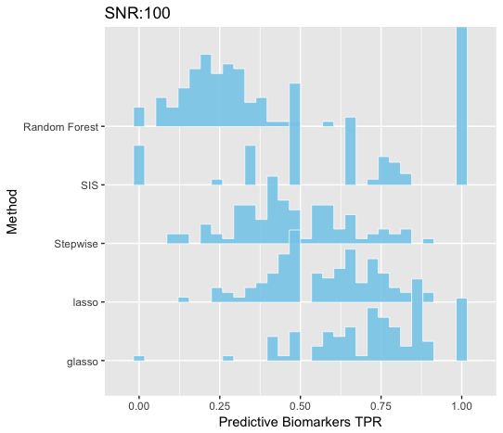
Distributions of TPR on Predictive Biomarkers Across All Simulations
SNR=100

Slide 45
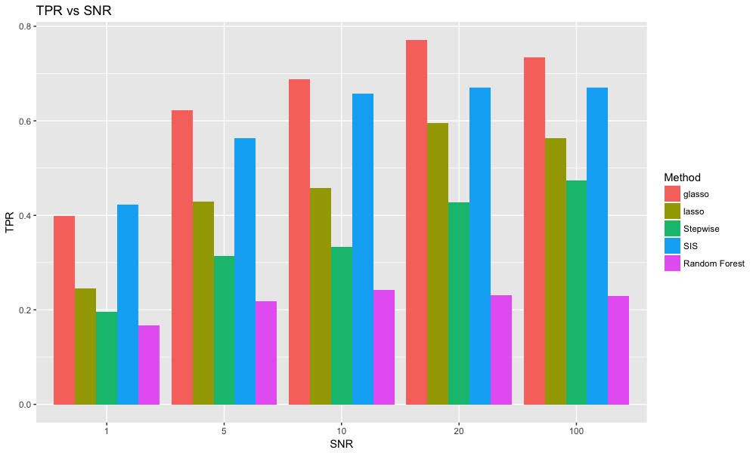

Slide 46
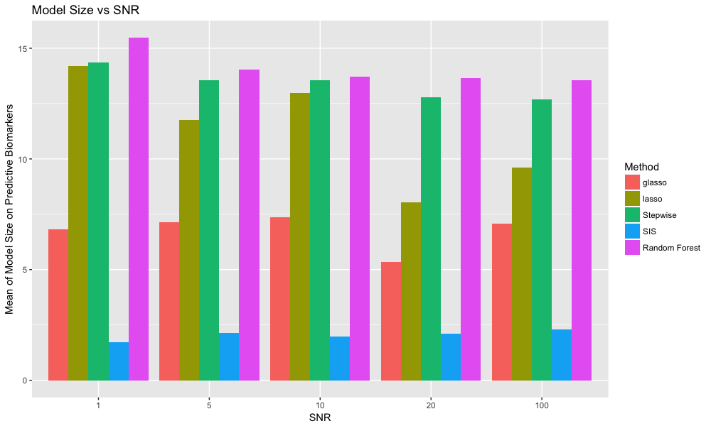

Slide 47
Other number of biomakers
Fixed SNR=10
Fixed proportion of nonzero predictive biomarkers: 10%
Fixed covariates data type: Standard Normal Distribution

Slide 48
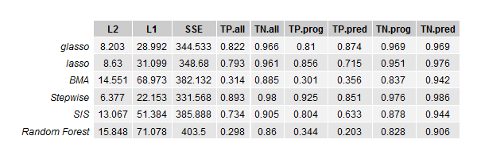
Dimension of genes=50 and total dimension=106

Slide 49
When number of biomarkers > sample size

Slide 50
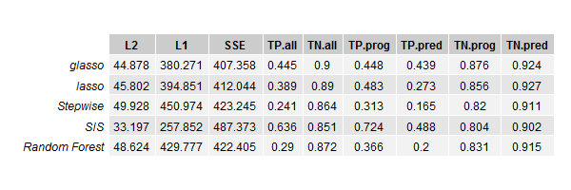
Dimension of genes=200 and total dimension=406

Slide 51
When covariates are SNP
Fixed number of genes: 100
Fixed proportion of nonzero predictive biomarkers: 10%
Fixed SNR=10

Slide 52
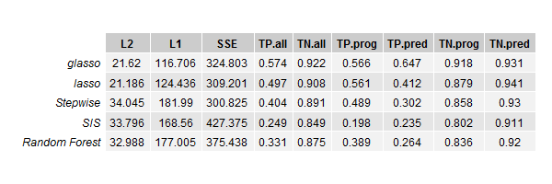
SNP

Slide 53
Real Data

Slide 54
Future Steps
Overlapping Simulations
Stop Criterion
Combination of Group Lasso with other methods
Endpoints

Slide 55
References

Slide 56
Thanks!

